Slide 1
Insights in FitBit Data
Presented by: Juan Rubio
Last Updated: Oct. 12th, 2023

Slide 2
Table of Contents
Objective
The Story as Told by the Data
Conclusion
Appendix

Slide 3
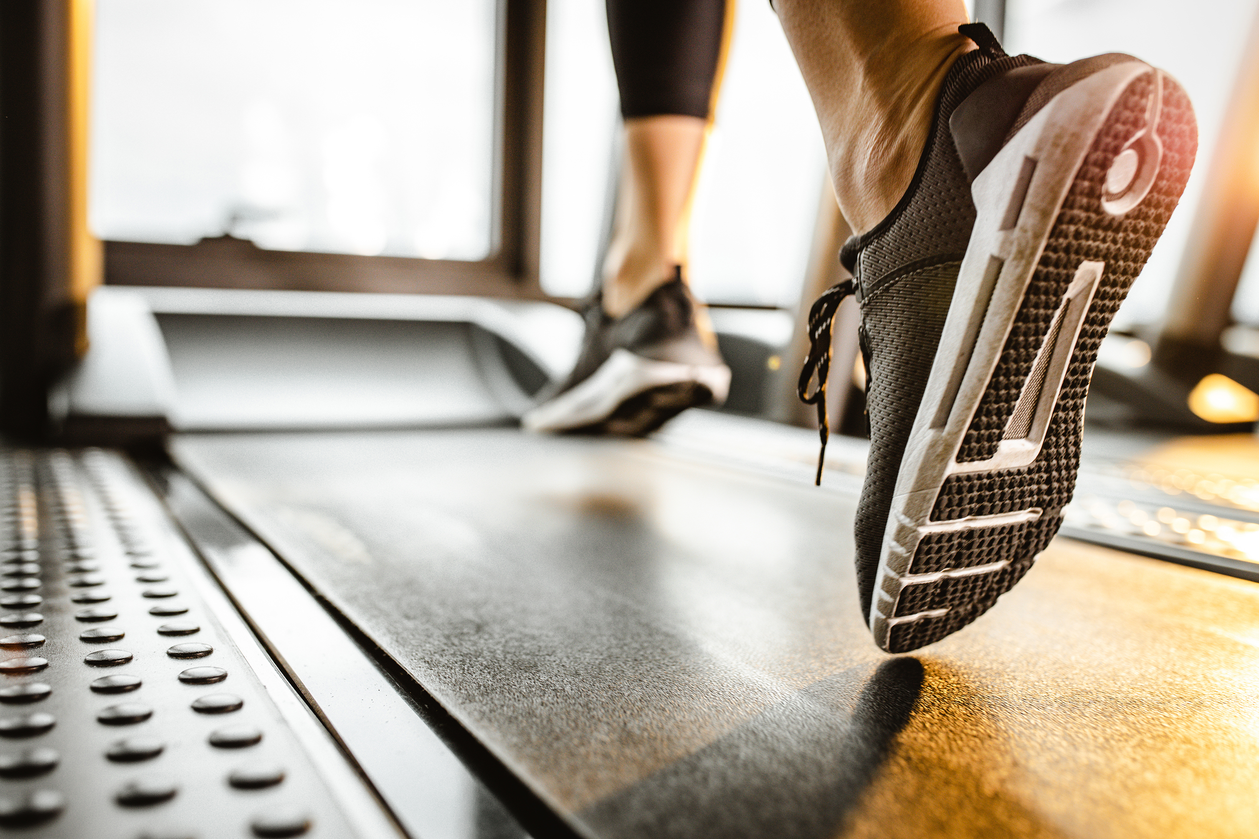
Who? What?
FitBit data
30 eligible users
Type of data collected
Notes:
The data used for the analysis was from fitbit devices. The data was collected from 30 different users and the devices used by these users varied.
The devices measured different kind of data like heart rate and daily activity. Activity was broken down into three categories, light activity, moderate activity, and very active activity. Sleep was also monitored by the devices.

Slide 4
Objective
Identify trends
Identify behaviors
Let data drive market strategies
Notes:
Our task was to draw conclusions about users who used non Bellabeat products. Thus, we used data about fitbit users to identify trends as told by the data. What kind of patterns were popular among these users? We were also tasked with learning more about the behavior of these individuals. Did more sleep mean that they would be more active? Finally, after identifying these trends and behaviors we would use them to influence how we would market our products and how we target our trending type of user.

Slide 5
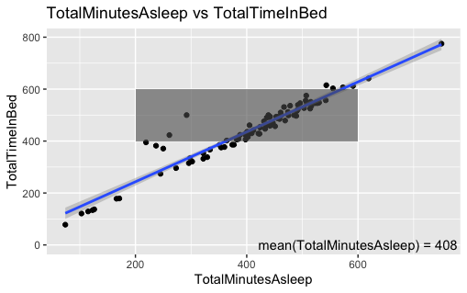
TotalMinutesAsleep vs. TotalTimeInBed
Average minutes of sleep
No sleeping problems
No correlation with activity
Notes:
The average of minutes asleep was 408 minutes which translates to 6 hours and 48 minutes. Most people fell into the 6 hour to 10 hours range of sleep. We created a scatter plot to illustrate relationships between total minutes of sleep and total minutes spent in bed, if any. The further to the right the point was, the more sleep an user obtained. The more up the point on the graph was, the more time in bed they spent. We can see here as time spent in bed increased, the minutes of sleep also increased. Thus, there is a correlation. Which tells us that people are not having trouble getting sleep. We then tried to find relationships between minutes of sleep and the different types of activity and found nothing. People who slept more did not out or under perform people who slept less.

Slide 6
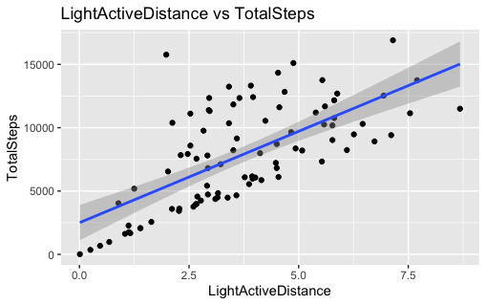
LightActiveDistance vs. TotalSteps
Correlation
Step statistics
Normal people
Notes:
We discovered that there was a correlation between LightActiveDistance and TotalSteps. As light active distance increased, the total number of steps also increased.
The average of total steps of all users was 7,853 with 16,901 being the max amount of steps taken by a person in a single day. The distance of very active activity and moderate activity did not differentiate as the total number of steps went up. Which tells us that the users were performing mostly light activities every day. We can infer that most of the users are normal people with constraints. These constraints could include having a full-time job but more research would be needed to identify these constraints if there is any. These relationships also tell us that most of these people are not athletes or people who train often.

Slide 7
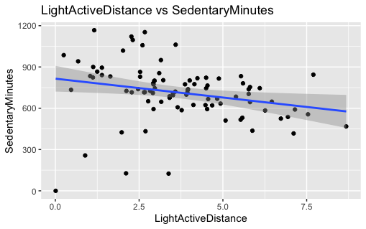
LightActiveDistance vs. SedentaryMinutes
A little correlation
Supports claim
Notes:
Although, it was not huge some correlation exist between light active distance and sedentary minutes. Sedentary minutes is the time an individual spent sitting down or not moving from a single place. As the minutes spent sitting down went down the number of light active distance increased. Which tells us that users were mostly getting up to perform light activities. This supports the claim that these users are mostly average individuals.

Slide 8

Conclusion
People who use these devices are normal people who are care about being healthy.
People who might not have the time or the accessibility to workout or train are the average users.
The average working-class person should be considered and felt included in our marketing strategies.

Slide 9

Thank you

